Slide 1
Ubuntu 17.10 (and before)
Home Folder Encryption – ecryptfs
(Part 1)
Waikato Linux User Group
Ian Stewart
24 Sep 2018

Slide 2
Introduction
Steps:
Boot a USB stick with Ubuntu Mate 17.10.
Perform installation to Hard Disk Drive (HDD).
During install create “ian” account with encryption.
Finish install and boot HDD.
Create “aurora” account with encryption.
Demo. Ian cant see Aurora’s files and vice versa.
Boot a Ubuntu Mate 17.10 USB stick.
Access the HDD.
Decrypt /home/ian/… folders and files.
Decrypt home/aurora/… folders and files.

Slide 3
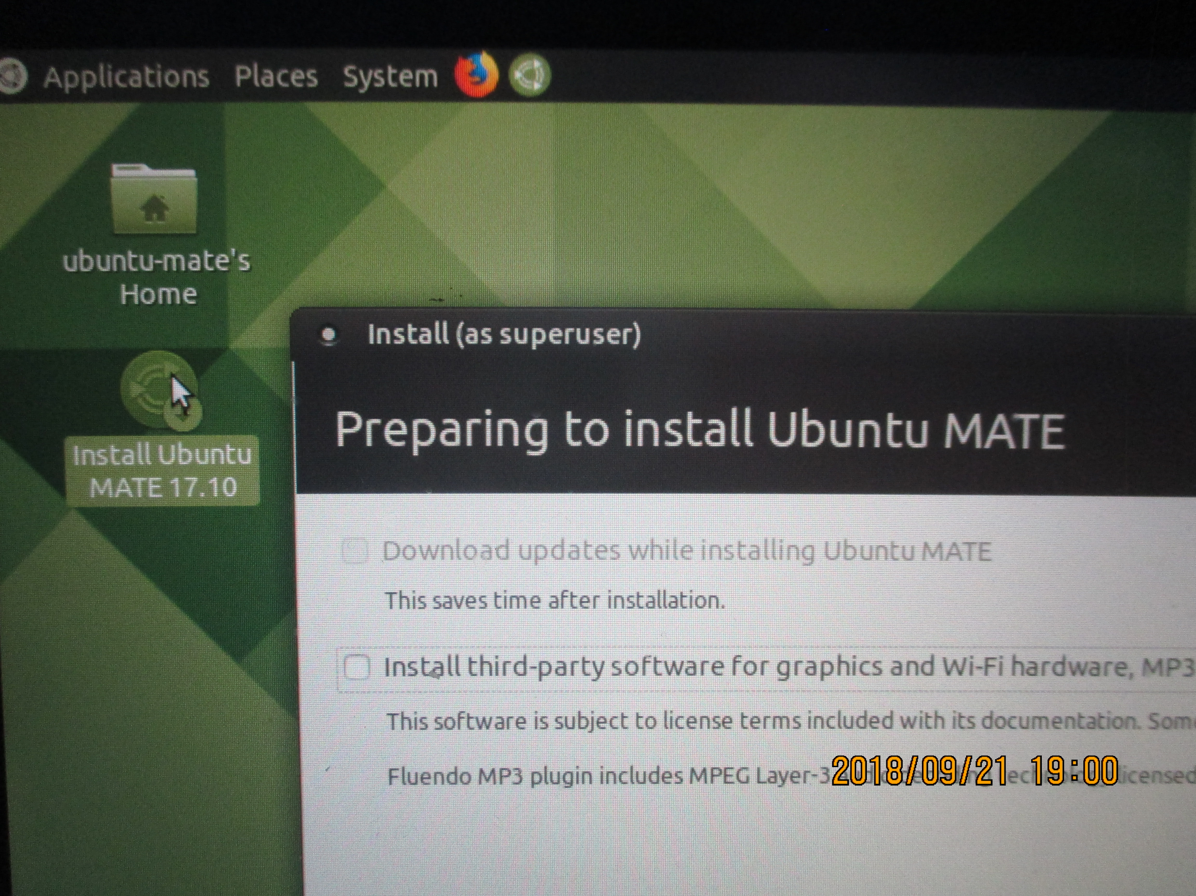
Booted a USB stick with Ubuntu Mate 17.10 and start install to Hard Disk Drive

Slide 4
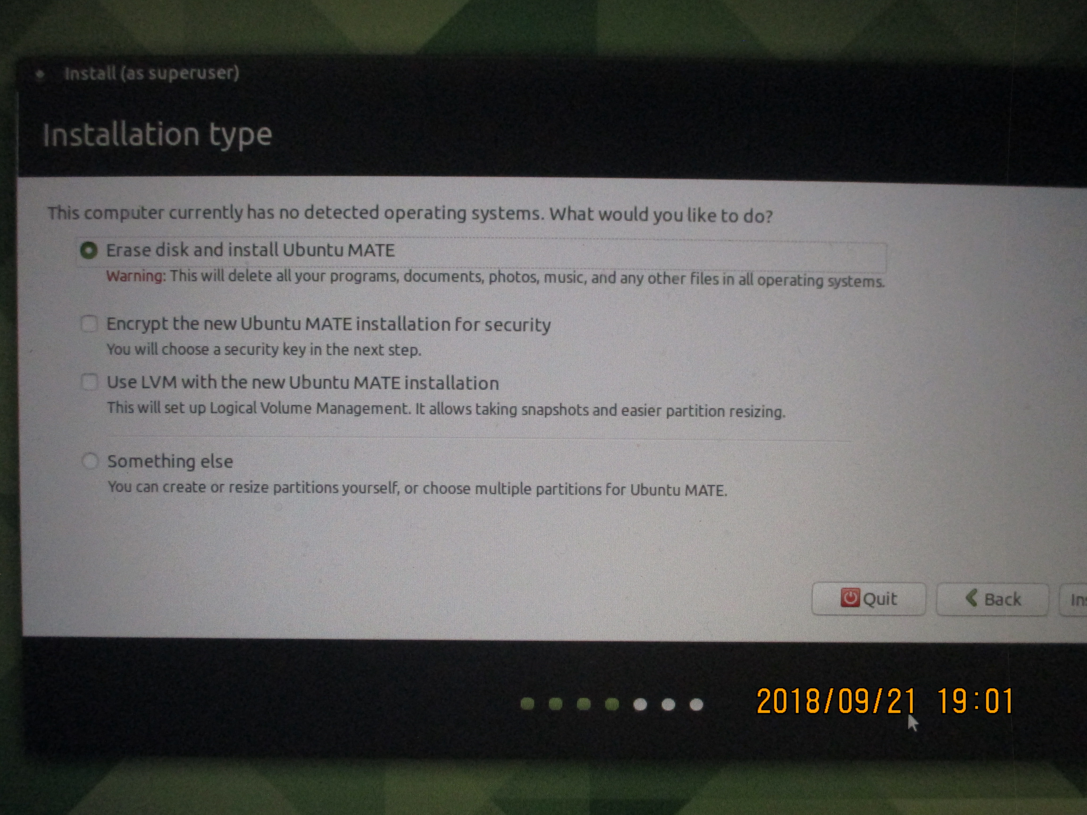
Create un-encrypted drive

Slide 5
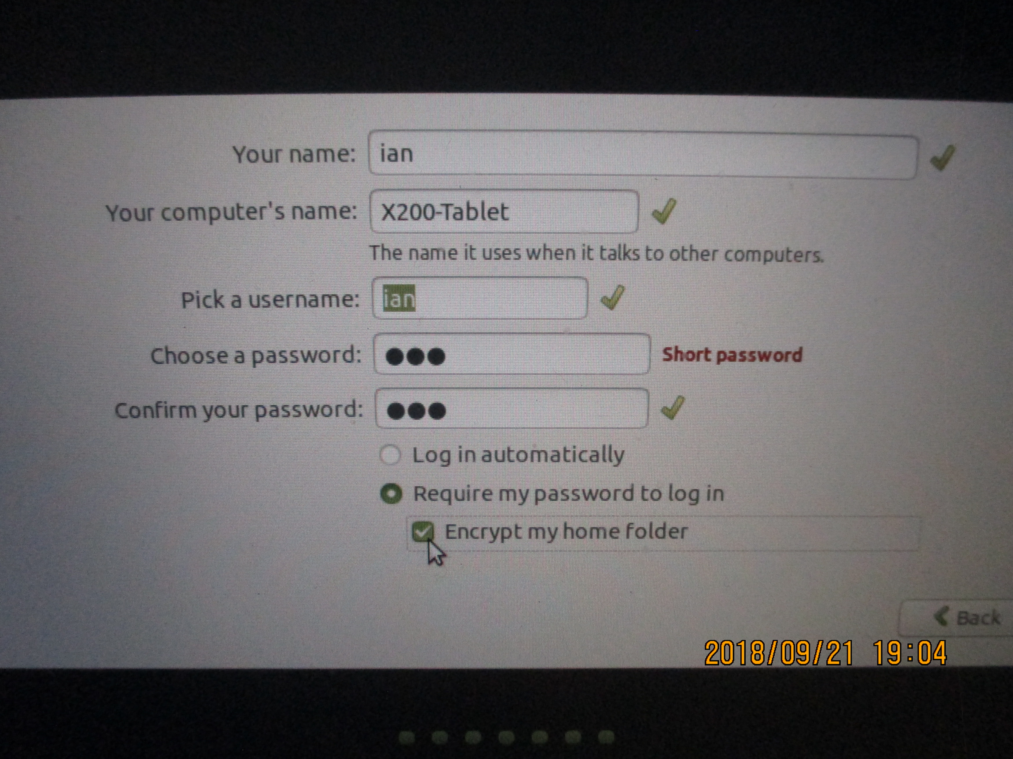
Create “ian” account and Encrypt home folder

Slide 6
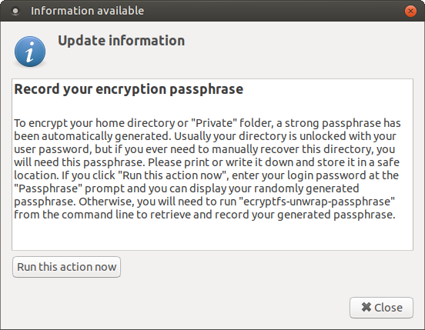
Boot HDD and log into “ian” for first time.
Prompted to Record Encryption Passphrase

Slide 7
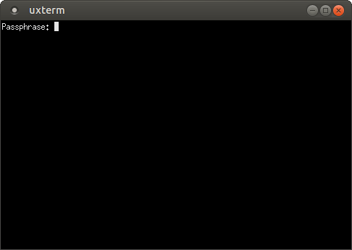
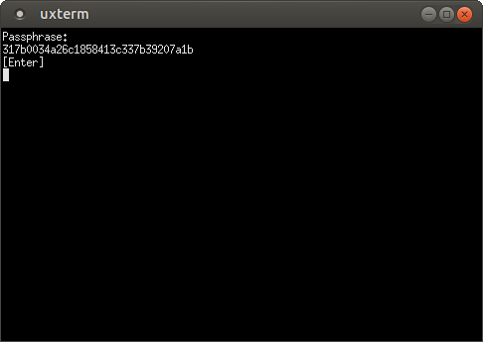
Enter login password for “ian” for first time.
Returns 32 hex character Passphrase

Slide 8
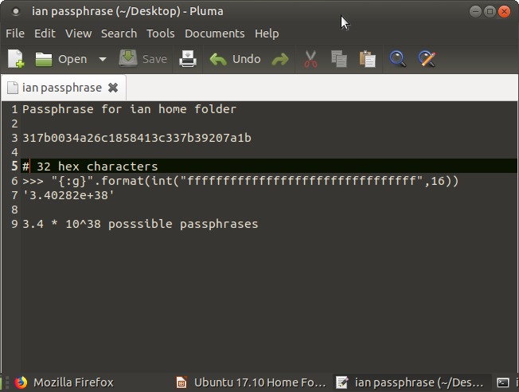
Open an editor and save the passphrase.
Note: Doesn’t cut and paste. Have to enter manually

Slide 9
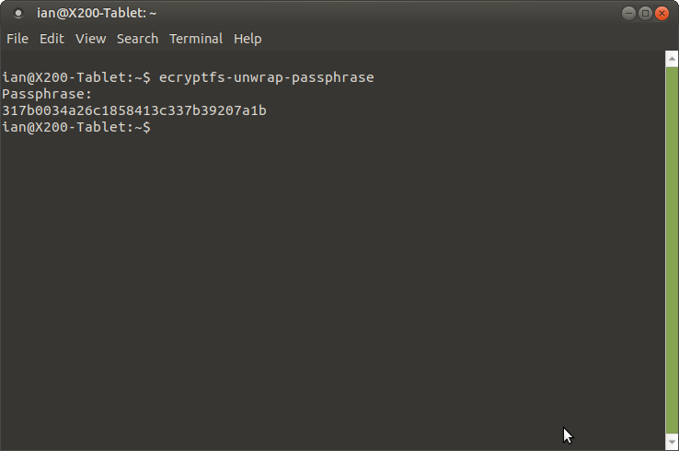
Open a terminal window. Run ecryptfs-unwrap-passphrase.
Passphrase can now be cut and pasted.

Slide 10
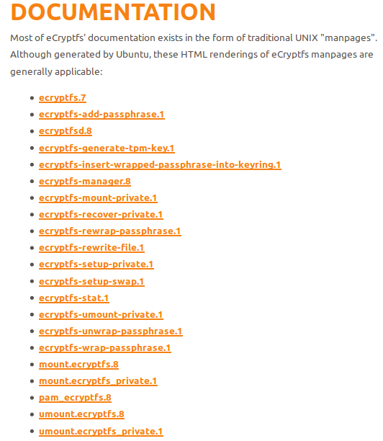
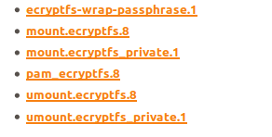
Aside: Syntax of ecryptfs utilities. ecryptfs.org
Use $ man ecryptfs-xxxxx

Slide 11
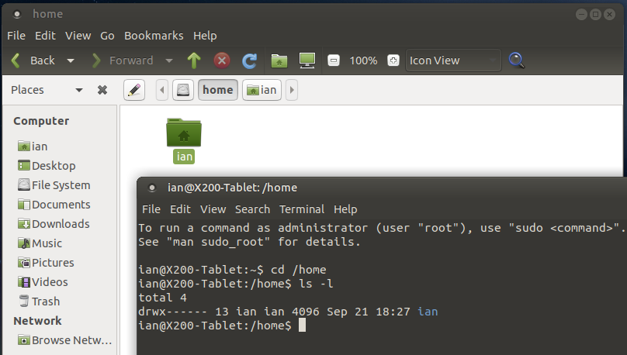
/home/ian appears normal from “ian” account

Slide 12
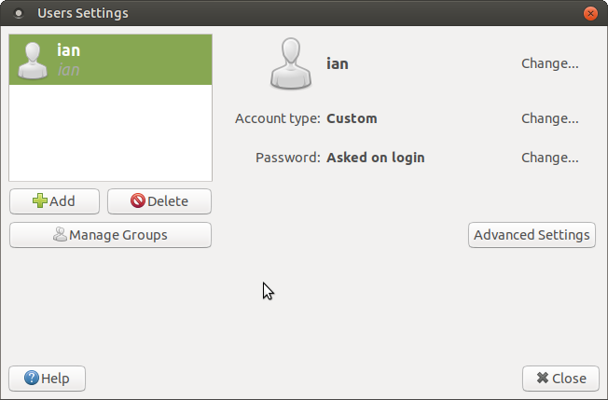
from “ian” account create an “aurora” account.
System→Control Center → Users and Groups

Slide 13
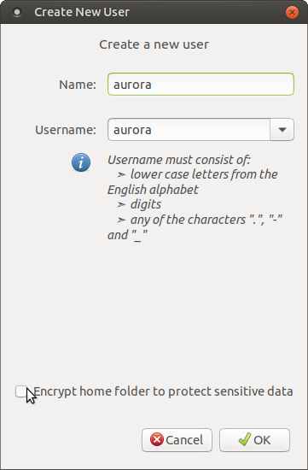
Create New User: “aurora”
Note: Encrypt home folder to protect sensitive data

Slide 14
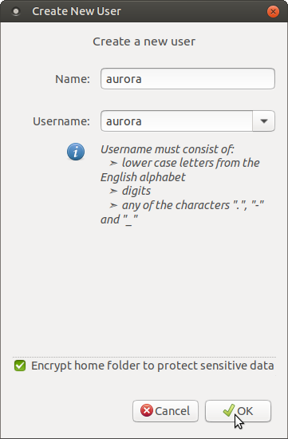
Create New User: “aurora”
Check to: Encrypt home folder to protect sensitive data

Slide 15
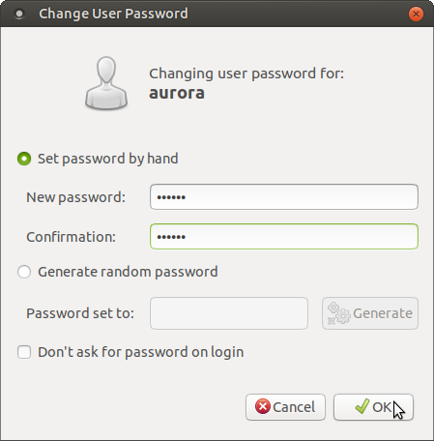
Change User Password: “aurora” changed it to “aurora”

Slide 16
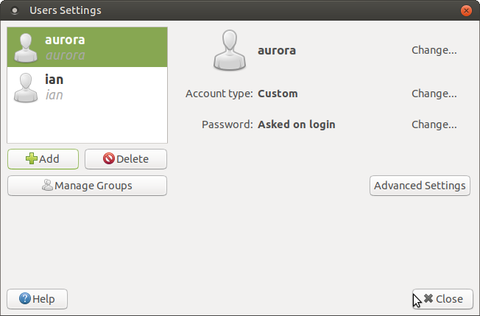
Aurora’s account now exists.
Now: Log out of “ian” and log into “aurora”.

Slide 17


After logging in to “aurora” for the first time.

Slide 18
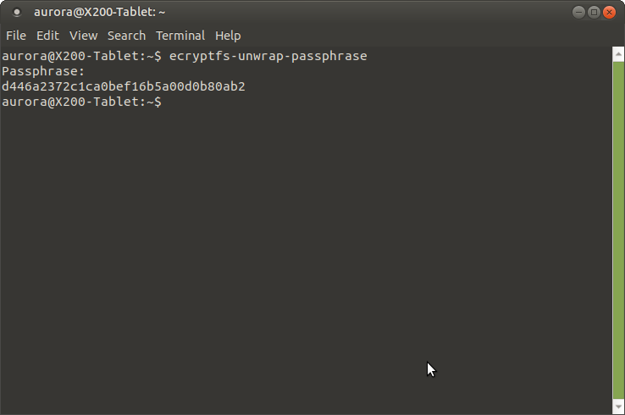

Using command line for the passphrase.
ggggggggggg

Slide 19
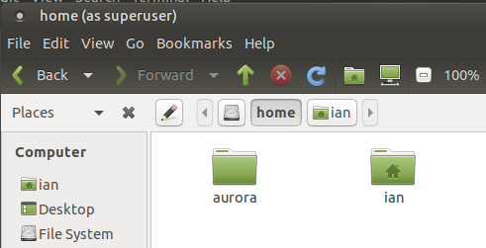
What if ian uses priv to look at aurora’s files?

Slide 20
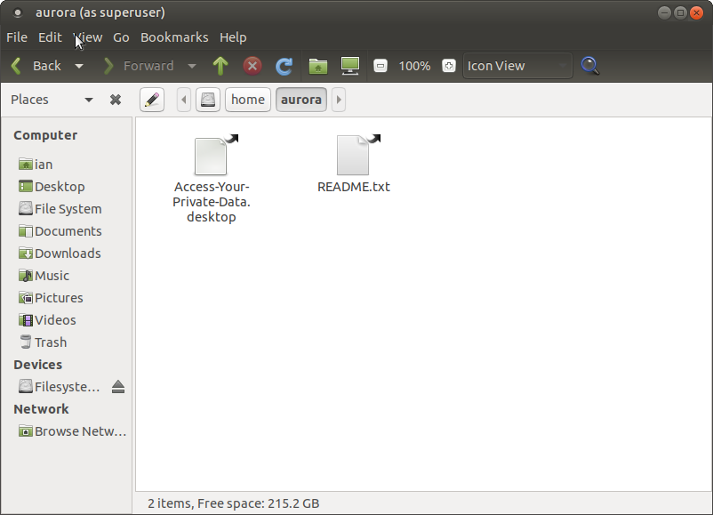
ian looking at: /home/aurora/

Slide 21
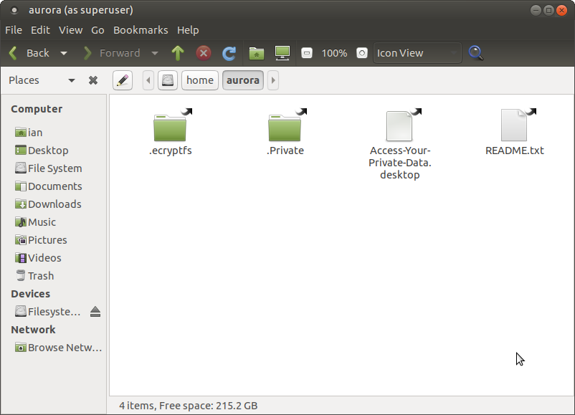
ian (with show hidden files) looking at: /home/aurora/

Slide 22
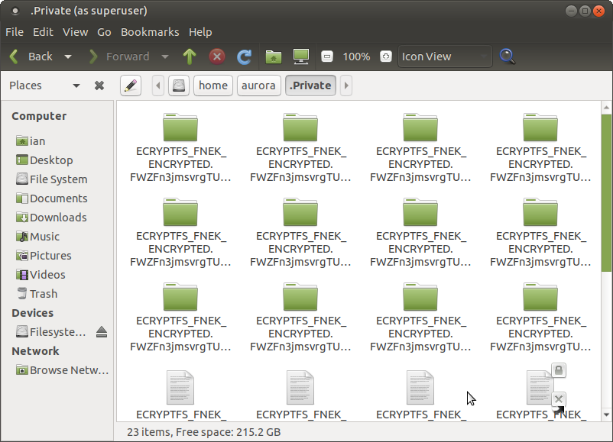
ian (with show hidden files) looking at: /home/aurora/.Private

Slide 23
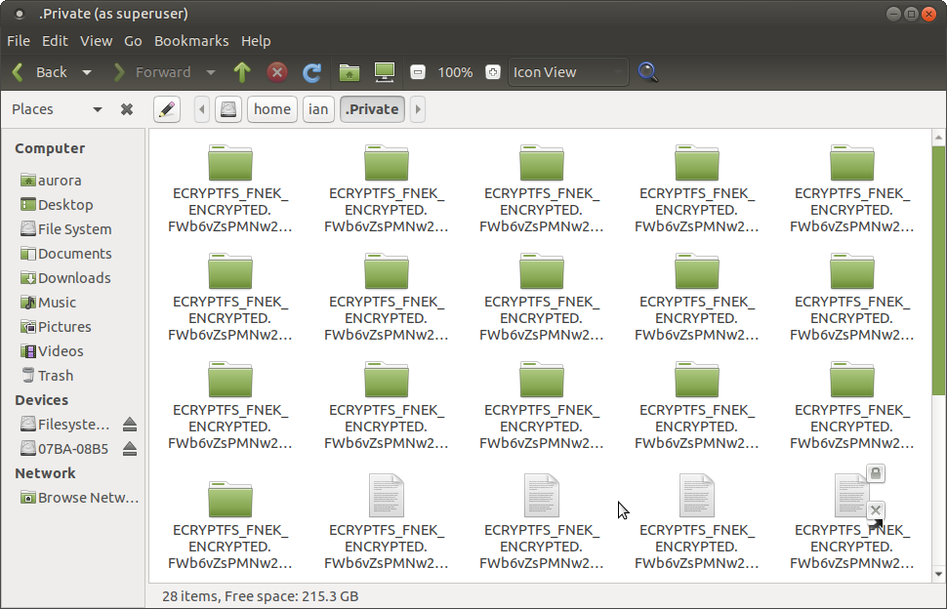
aurora (with show hidden files) looking at: /home/ian/.Private

Slide 24
What if there is a problem and we are unable to boot the HDD.
How do we use the ecryptfs utilities from a USB stick or Live CD system, to access and decrypt “ian” and “aurora” folders and files?

Slide 25
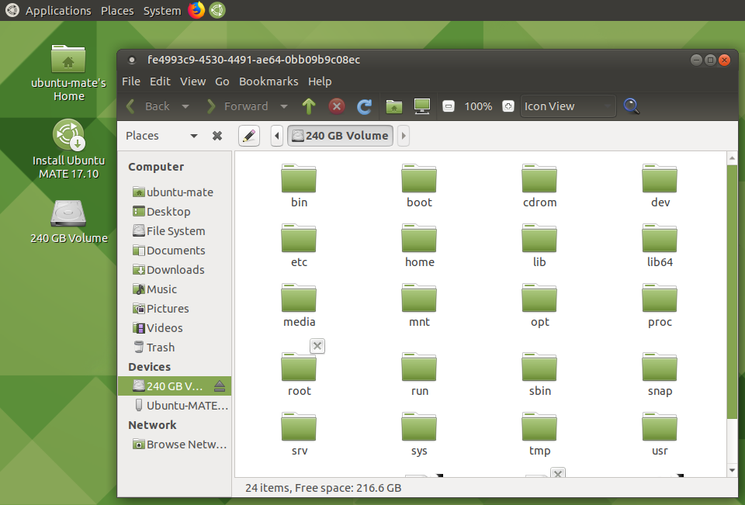
Boot from USB stick with ubuntu mate 17.10.
View the 240GB HDD.

Slide 26
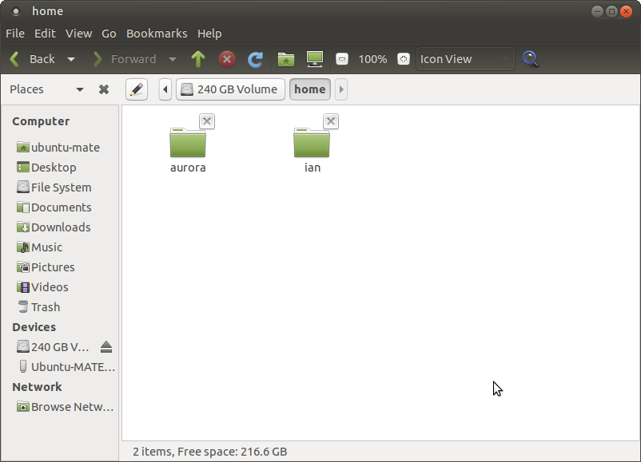
Home folder shows “aurora” and “ian” as locked.

Slide 27
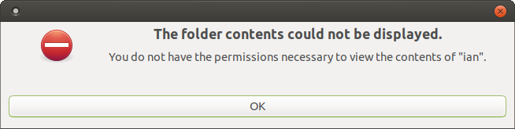
Unable to open “ian” folder.

Slide 28
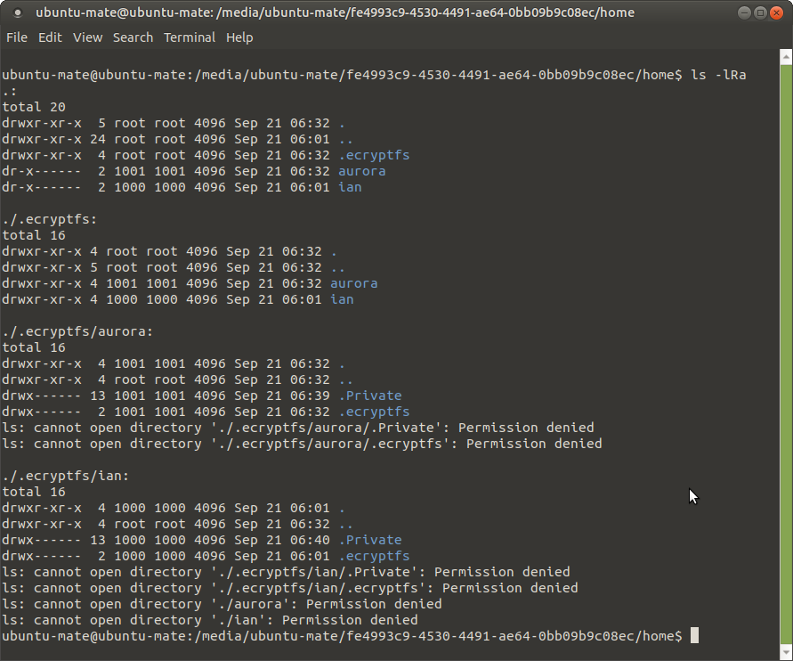
Use “ls -lRa” to observe the home folders
Note the hidden folders:
.encryptfs
.Private

Slide 29
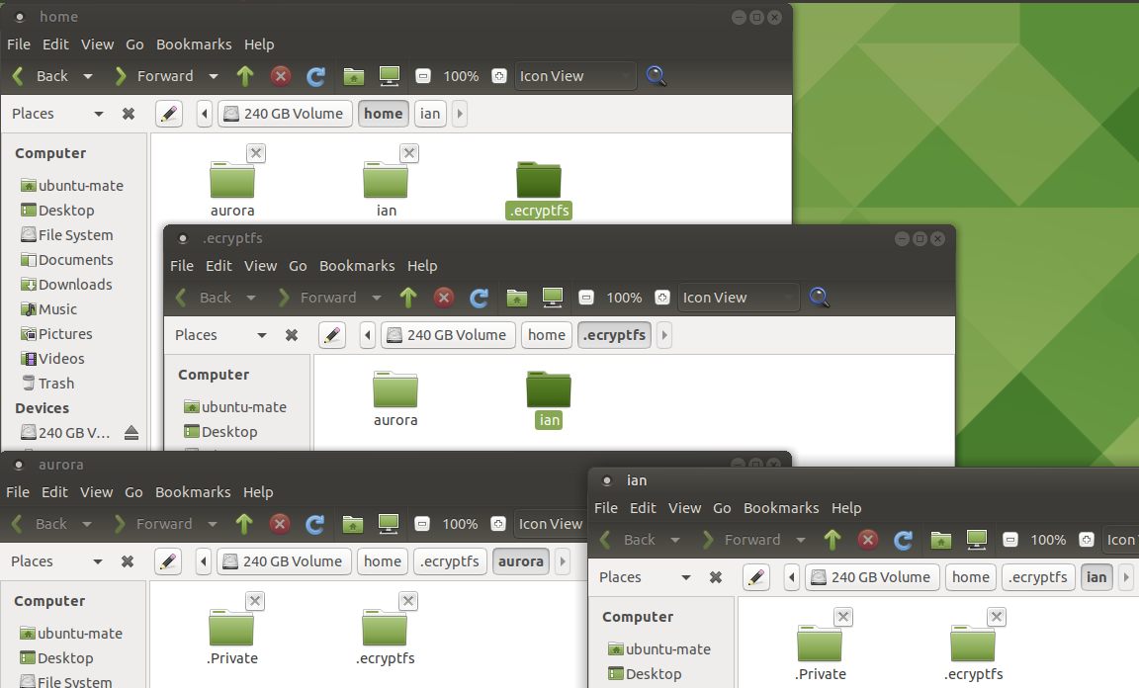
GUI File Manager “show hidden files”.

Slide 30
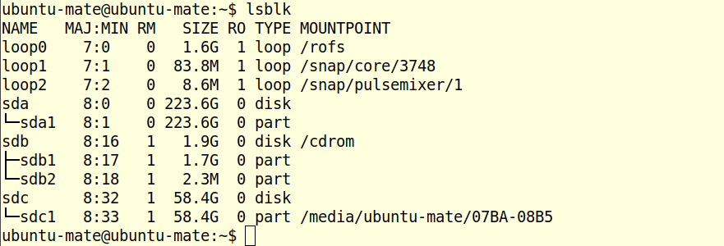
Can 17.10 Ubuntu USB stick get the data?
Using lsblk we see sda1 is the 223GB HDD partition.

Slide 31
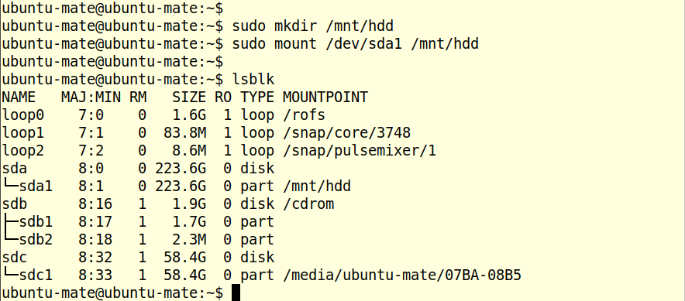
Mount the HDD. sudo mount /dev/sda1 /mnt/hdd

Slide 32
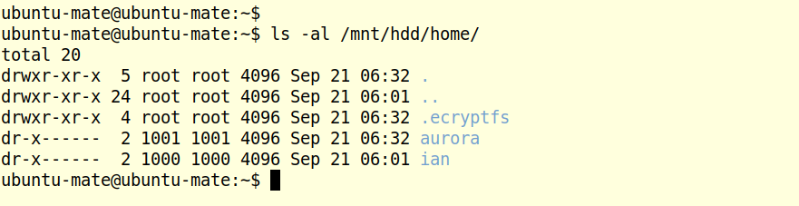
Review the /mnt/hdd/home/
Includes: “aurora” and “ian” plus “.ecryptfs”

Slide 33
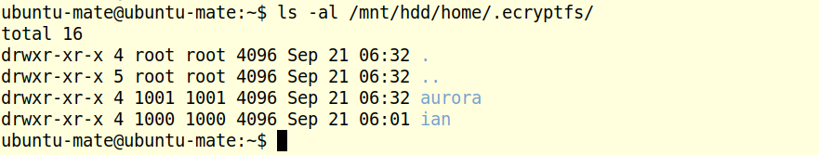
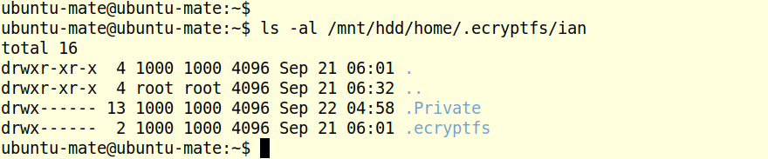
Review the /mnt/hdd/home/.ecryptfs/
Review the /mnt/hdd/home/.ecryptfs/ian/

Slide 34

Review the /mnt/hdd/home/.ecryptfs/ian/.Private
Permission Denied

Slide 35
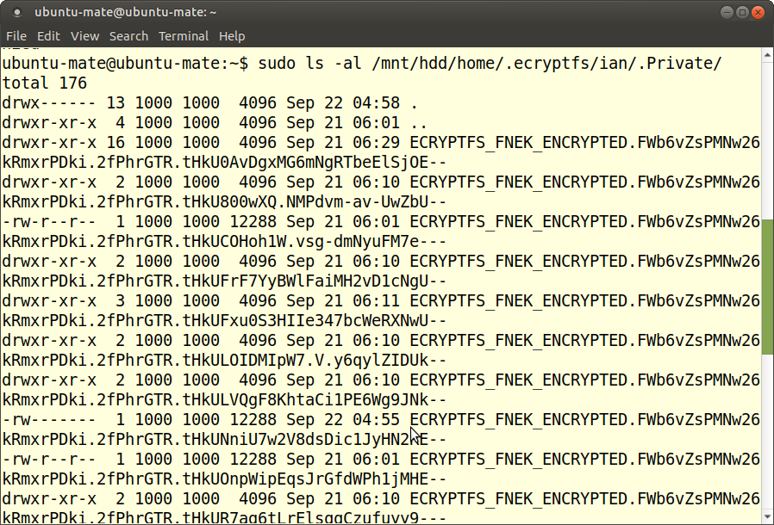
Use sudo to review /mnt/hdd/home/.ecryptfs/ian/.Private

Slide 36
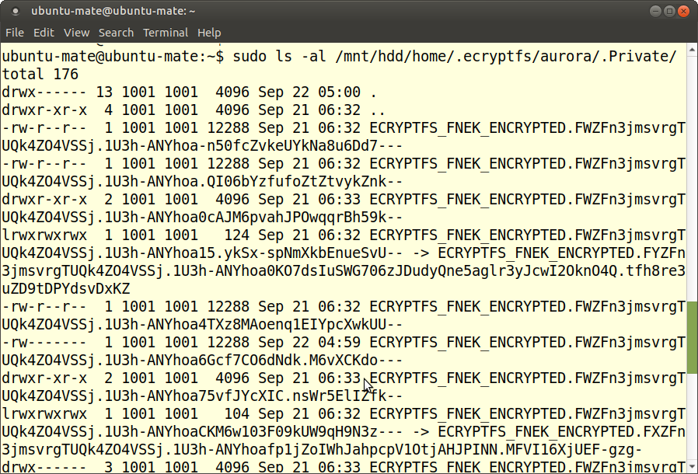
Use sudo to review /mnt/hdd/home/.ecryptfs/aurora/.Private

Slide 37
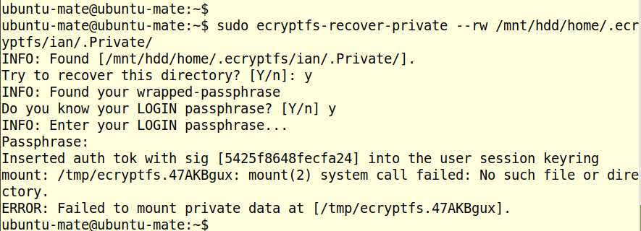
Try using ecryptfs-recover-private
Fails to mount private data in /tmp/

Slide 38

Work-around to ecryptfs-recover-private

Slide 39
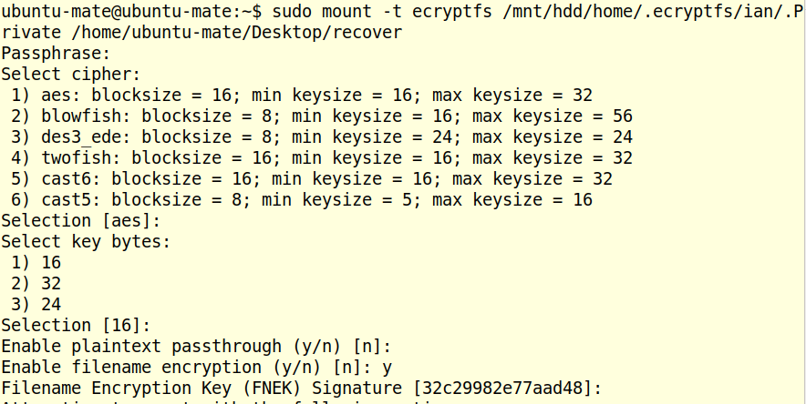
$ sudo mount –t ecryptfs (1/2)

Slide 40
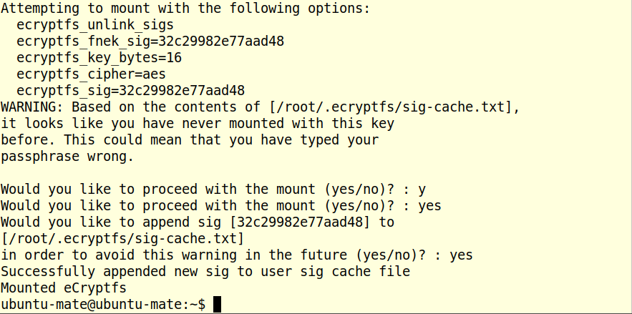
$ sudo mount -t ecryptfs (2/2)

Slide 41
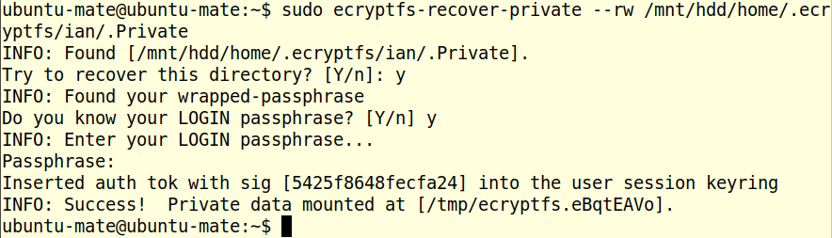
Try again: $ sudo ecryptfs-recover-private for “ian”

Slide 42
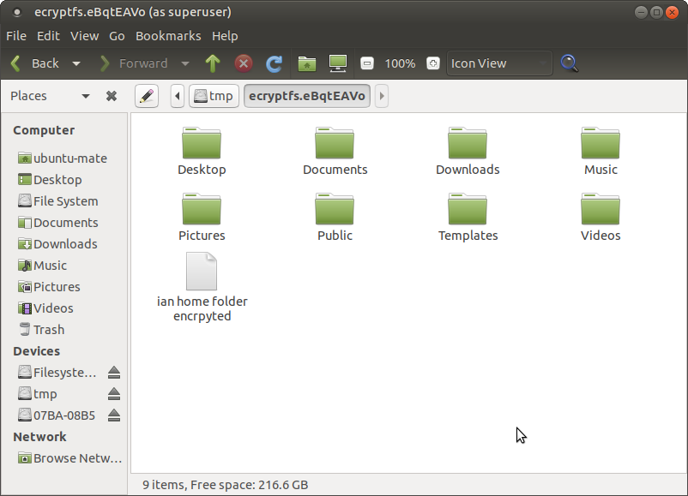
Review /tmp/eBqtEAVo folder with “ian” data

Slide 43
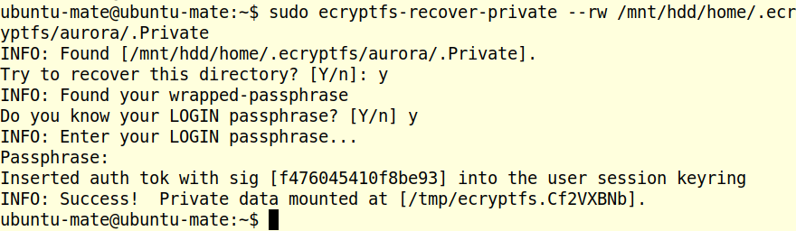
ecryptfs-recover-private for “aurora”

Slide 44
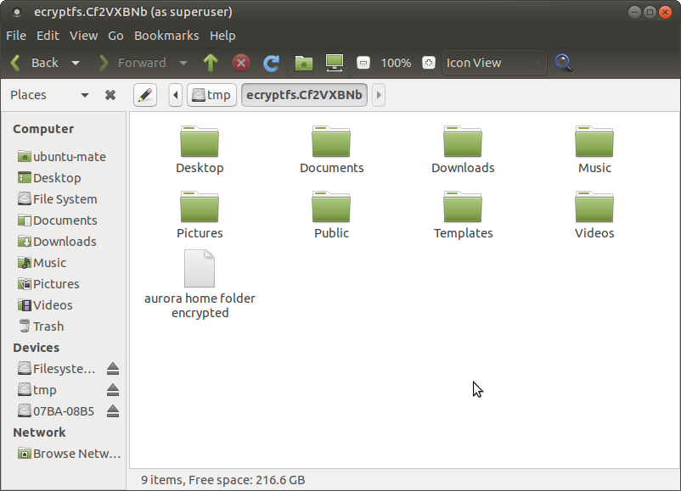
Review /tmp/Cf2VXBNb for “aurora” data

Slide 45
Data in “ian” and “aurora” can now be copied / backed-up.
End of presentation on using ecryptfs on ubuntu 17.10 (or earlier versions).

